Slide 1
AUTO ENCODER SYSTEM FOR INTRUSION DETECTION

Slide 2
Abstract
Web applications are popular targets for cyber-attacks because they are network-accessible and often contain vulnerabilities. An intrusion detection system monitors web applications and issues alerts when an attack attempt is detected. Existing implementations of intrusion detection systems usually extract features from network packets or string characteristics of input that are manually selected as relevant to attack analysis. Manually selecting features, however, is time-consuming and requires in-depth security domain knowledge

Slide 3
INTRODUCTION
A web application may comprise multiple components where multiple agents are attached. Likewise, multiple instances of the application may run on different physical hardware for scalability. It is important for agents to communicate effectively with our machine learning backend to process collected traces, which requires some means of mapping the task- and application-level abstractions onto physical computing resources.

Slide 4
LITERATURE SURVEY
A classification of sql-injection attacks and countermeasures
AUTHORS: Halfond WG, Viegas J, Orso A.
ABSTRACT:SQL injection attacks pose a serious security threat to Web applications: they allow attackers to obtain unrestricted access to the databases underlying the applications and to the potentially sensitive information these databases contain. Although researchers and practitioners have proposed various methods to address the SQL injection problem, current approaches either fail to address the full scope of the problem or have limitations that prevent their use and adoption

Slide 5
LITERATURE SURVEY
An adaptive network intrusion detection method based on pca and support vector machines. Advanced Data Mining and Applications.
AUTHORS: Xu X, Wang X.
ABSTRACT: Network intrusion detection is an important technique in computer security. However, the performance of existing intrusion detection systems (IDSs) is unsatisfactory since new attacks are constantly developed and the speed of network traffic volumes increases fast. To improve the performance of IDSs both in accuracy and speed, this paper proposes a novel adaptive intrusion detection method based on principal component analysis (PCA) and support vector machines (SVMs)

Slide 6
LITERATURE SURVEY
Using Adaptive Alert Classification to Reduce False Positives in Intrusion Detection
AUTHORS: Pietraszek T.
ABSTRACT: Intrusion Detection Systems (IDSs) are used to monitor computer systems for signs of security violations. Having detected such signs, IDSs trigger alerts to report them. These alerts are presented to a human analyst, who evaluates them and initiates an adequate response. In practice, IDSs have been observed to trigger thousands of alerts per day, most of which are false positives (i.e. alerts mistakenly triggered by benign events).

Slide 7
LITERATURE SURVEY
An anomaly detection method to detect web attacks using stacked auto-encoder
AUTHORS: Ali Moradi Vartouni,Saeed Sedighian Kashi,Mohammad Teshnehlab
ABSTRACT: Network borne attacks are currently major threats to information security. Enormous efforts such as scanners, encryption devices, intrusion detection systems and firewalls have been made to mitigate these attacks. Web application firewalls use intrusion detection techniques to protect servers form HTTP traffic and, Machine learning algorithms have used based on anomaly detection in these firewalls.

Slide 8
EXISTING SYSTEM
Existing implementations of intrusion detection systems usually extract features from network packets or string characteristics of input that are manually selected as relevant to attack analysis. Manually selecting features, however, is time-consuming and requires in-depth security domain knowledge. Moreover, large amounts of labeled legitimate and attack request data are needed by supervised learning algorithms to classify normal and abnormal behaviors, which is often expensive and impractical to obtain for production web applications.
DISADVANTAGES OF EXISTING SYSTEM:
Lack of identifying attacks in web application.
Researchers found that more than half of web applications during a 2015-2016 scan contained high security vulnerabilities

Slide 9
PROPOSED SYSTEM
In this paper author is describing concept to detect attacks from web application using Deep Learning Network and Robust Software Modelling Tool (RSMT). RSMT tool is a web monitoring tool which monitor execution behaviour of web application and record in a trace file. Trace file contains low dimensional raw data and it cannot be used for Deep Learning Network. To convert this raw data to deep learning features author is using auto encoder technique. Auto encoder will convert raw data into deep learning features. This features will be passes to propose AutoEncoder algorithm which will generate train and test data from features. AutoEncoder algorithm require un-label train data to generate model and new test data will be applied on AutoEncoder train model to identify new test data is a normal request or contains attack. If new test data not available in AutoEncoder train model then it will be consider as attack.
ADVANTAGES OF PROPOSED SYSTEM:
we are using LSTM (Long Short Term Memory) Algorithm which is an advance version of deep learning network whose prediction accuracy is more compare to existing algorithms.

Slide 10
REQUIRMENTS
SOFTWARE REQUIREMENTS
The functional requirements or the overall description documents include the product perspective and features, operating system and operating environment, graphics requirements, design constraints and user documentation.
The appropriation of requirements and implementation constraints gives the general overview of the project in regards to what the areas of strength and deficit are and how to tackle them.
Python idel 3.7 version (or)
Anaconda 3.7 ( or)
Jupiter (or)
Google colab

Slide 11
REQUIRMENTS
HARDWARE REQUIREMENTS
Minimum hardware requirements are very dependent on the particular software being developed by a given Enthought Python / Canopy / VS Code user. Applications that need to store large arrays/objects in memory will require more RAM, whereas applications that need to perform numerous calculations or tasks more quickly will require a faster processor.
Operating system : windows, linux
Processor : minimum intel i3
Ram : minimum 4 gb
Hard disk : minimum 250gb

Slide 12
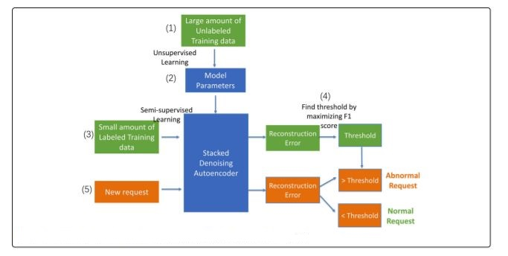
SYSTEM ARCHITECTURE

Slide 13
UML DIAGRAMS

Slide 14
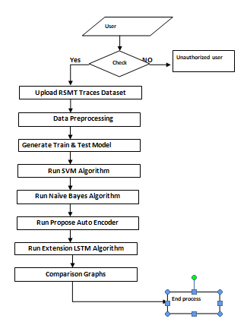
DATAFLOW DIAGRAM

Slide 15
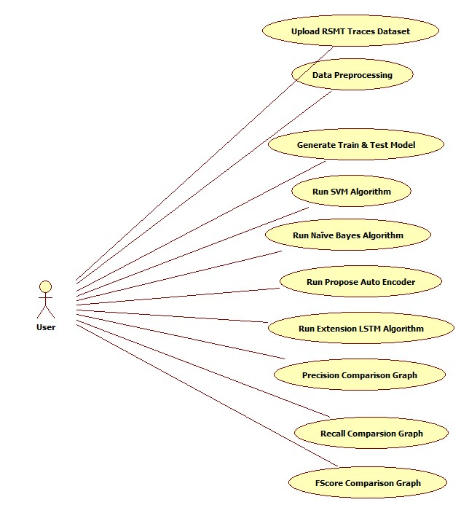
USECASE DIAGRAM

Slide 16
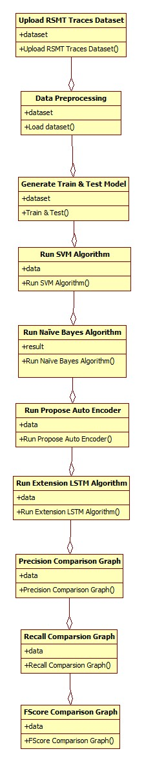
CLASS DIAGRAM

Slide 17
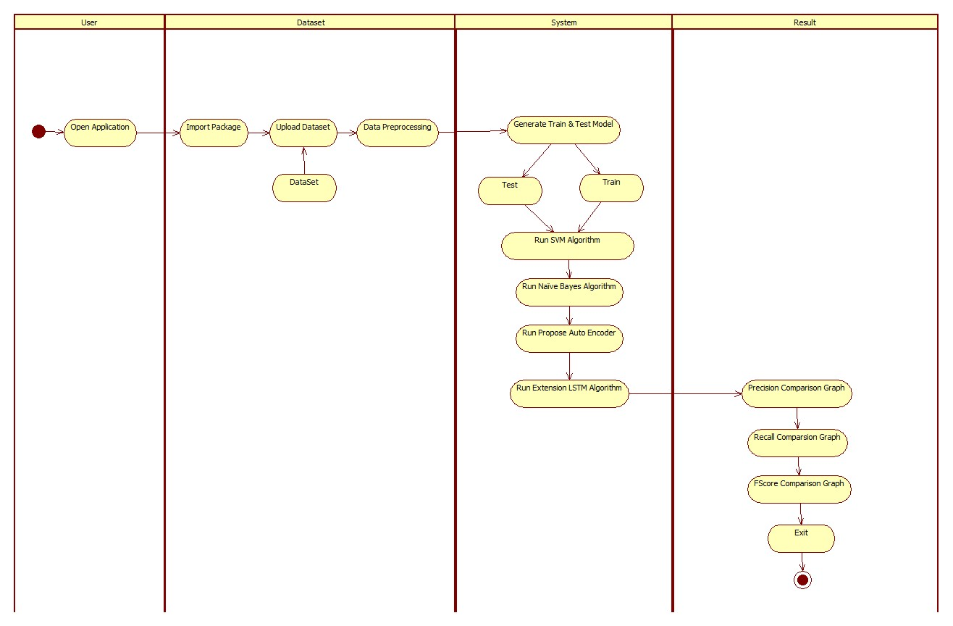
ACTIVITYDIAGRAM

Slide 18
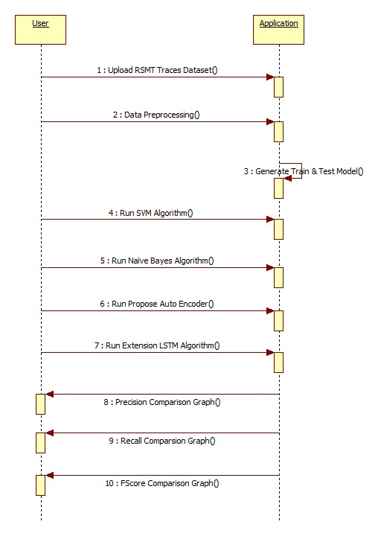
SEQUENCE DIAGRAM

Slide 19
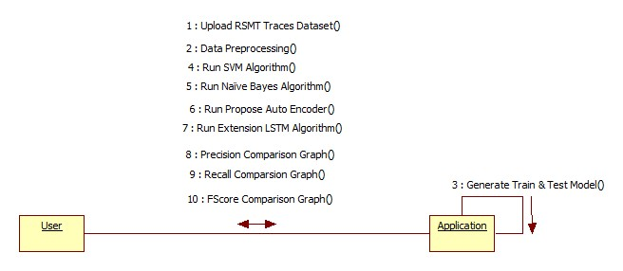
COLLABORATION DIAGRAM

Slide 20
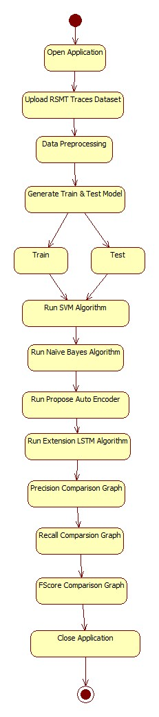
STATE DIAGRAM

Slide 21
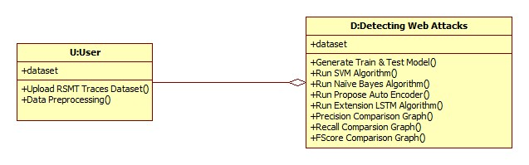
OBJECT DIAGRAM

Slide 22
MODULES
Using RSMT tool we will monitor web application behaviour and then record all execution traces to dataset.
Convert raw RSMT traces to deep learning features.
Generate AutoEncoder train model on un-label features to generate train model.
Apply test data on AutoEncoder train model to calculate prediction accuracy, precision, recall and FMeasure.

Slide 23
RESULTS

Slide 24
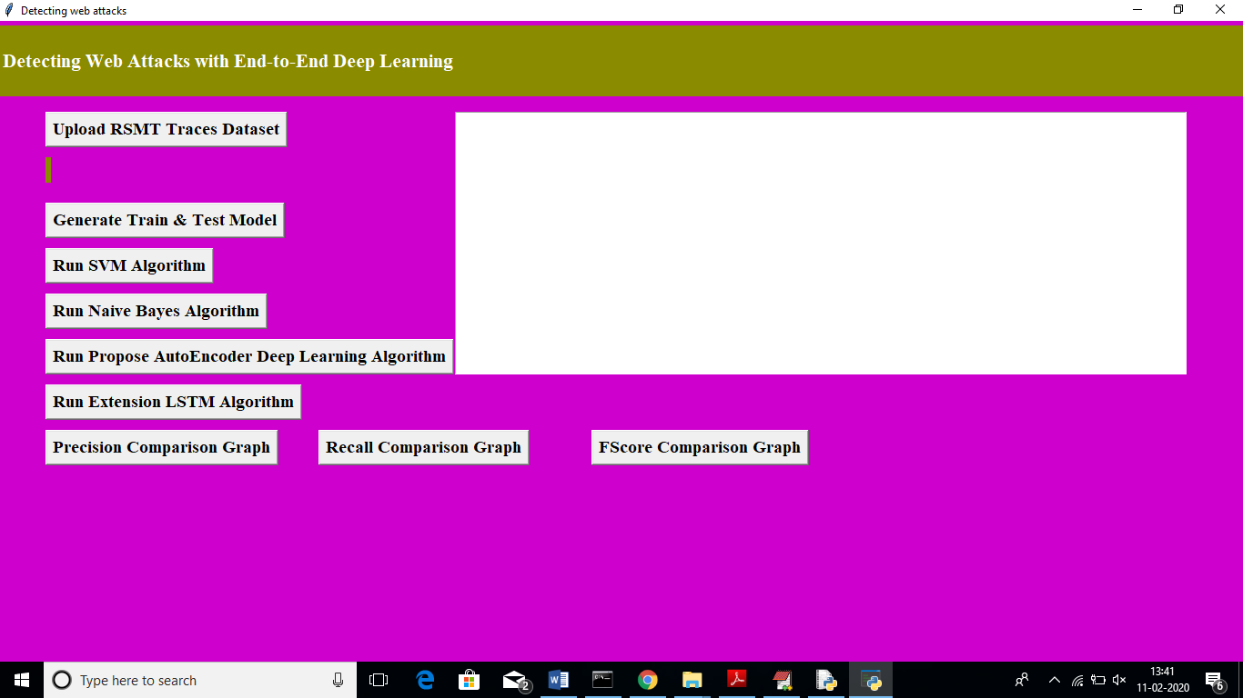

Slide 25
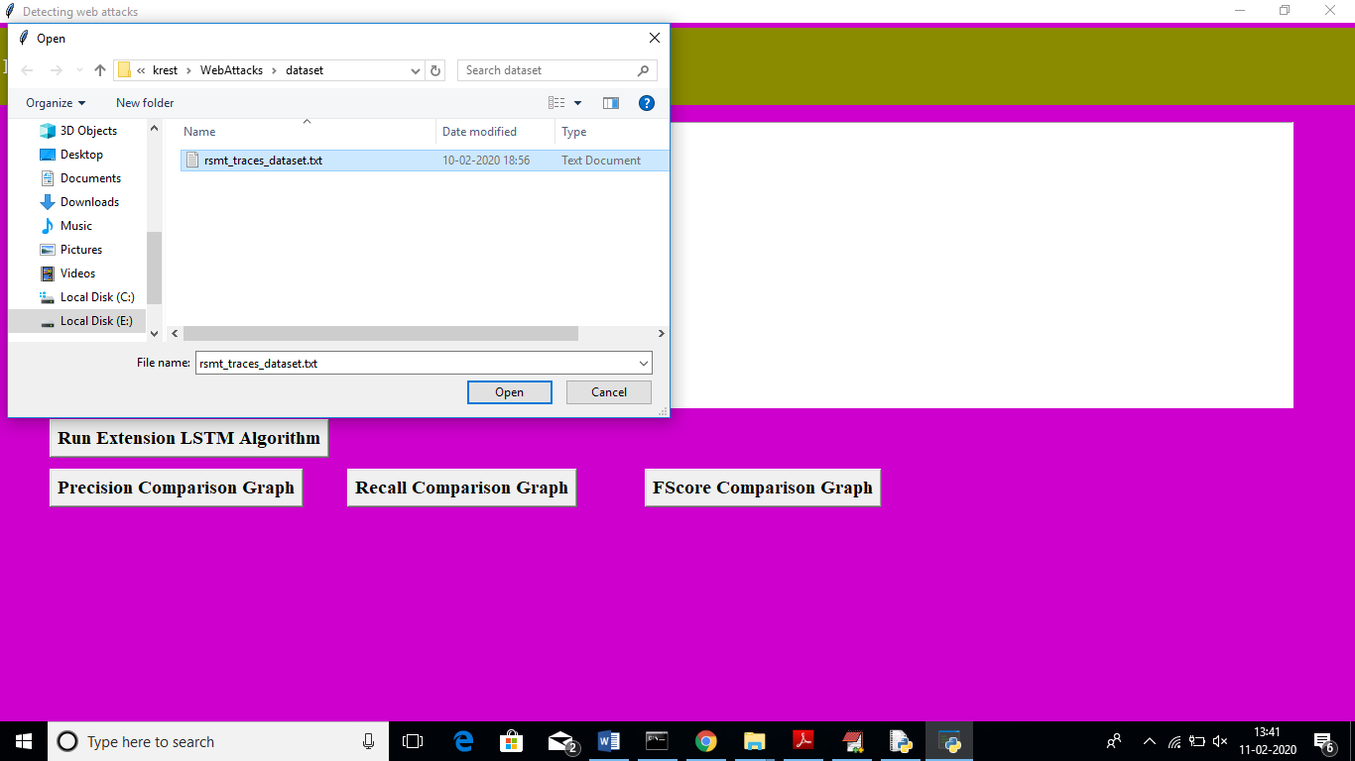

Slide 26
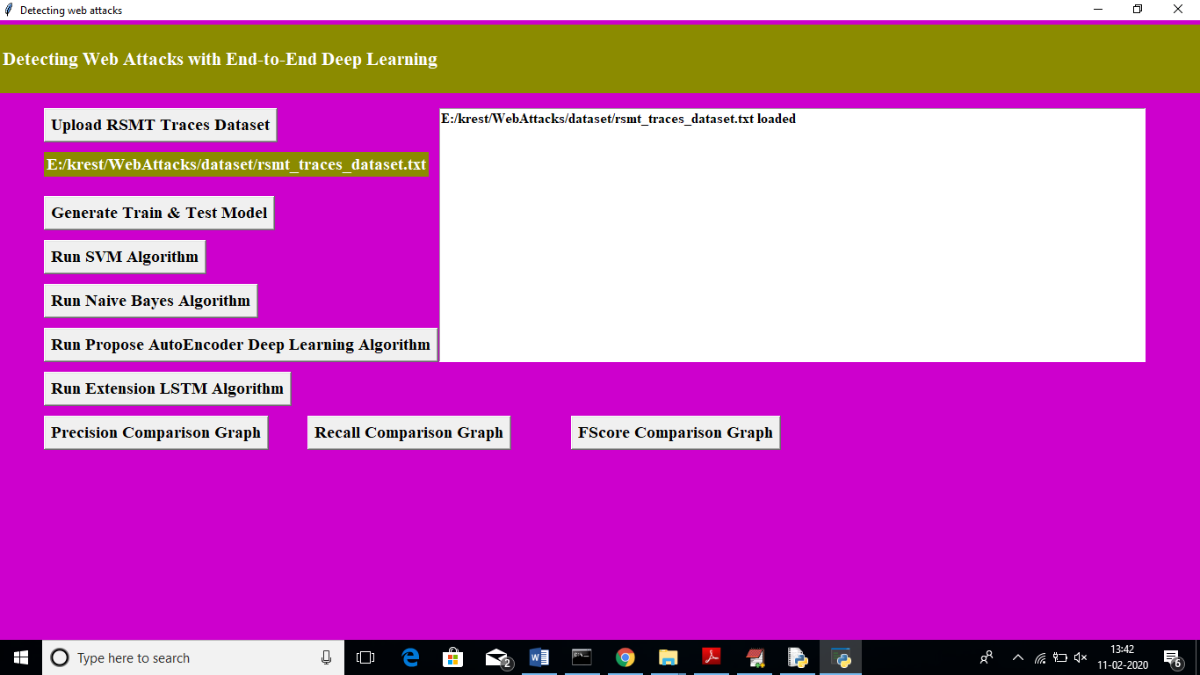

Slide 27


Slide 28


Slide 29


Slide 30
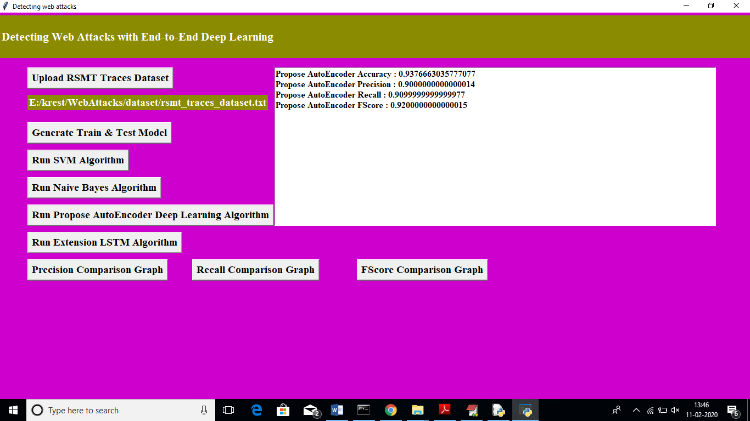

Slide 31


Slide 32
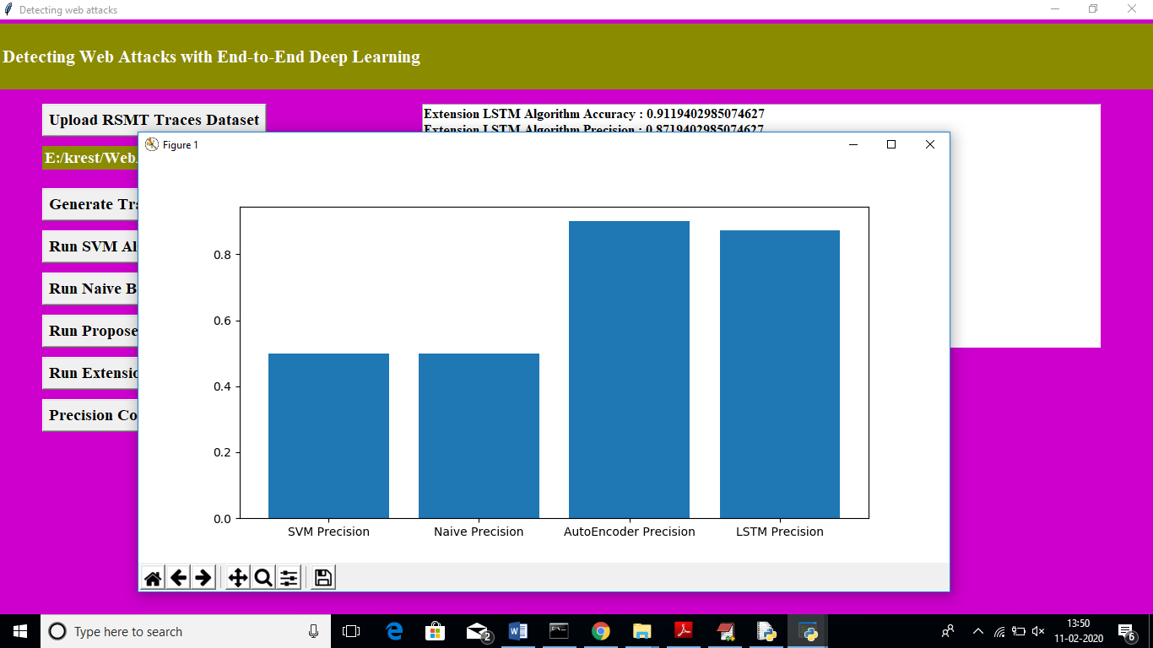

Slide 33
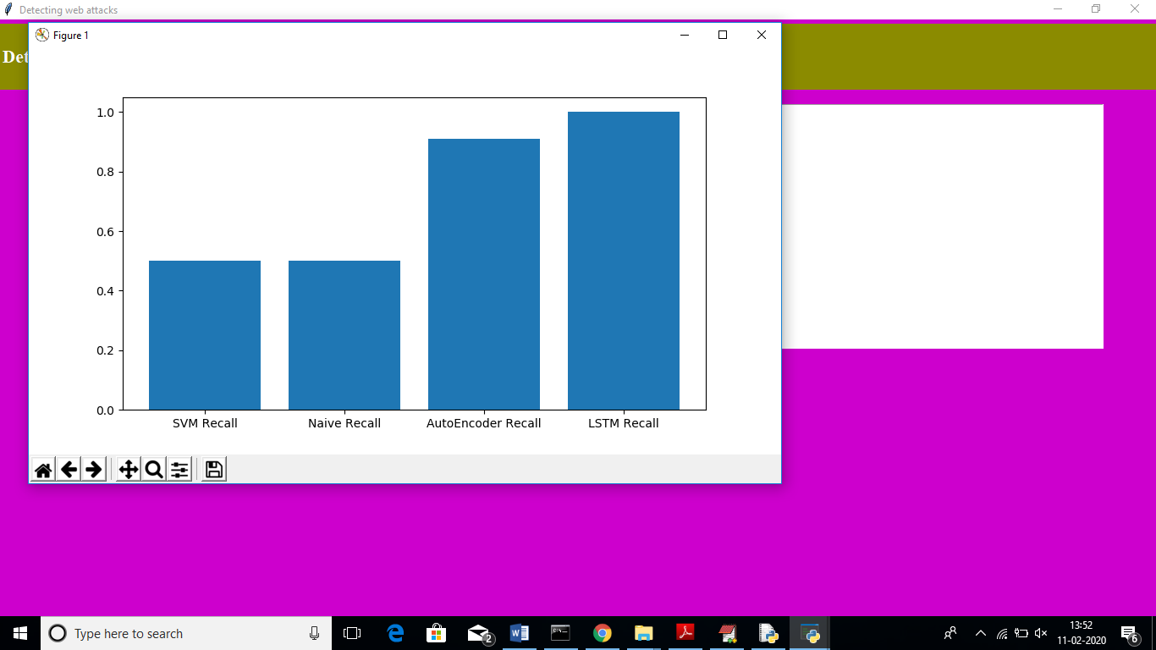

Slide 34
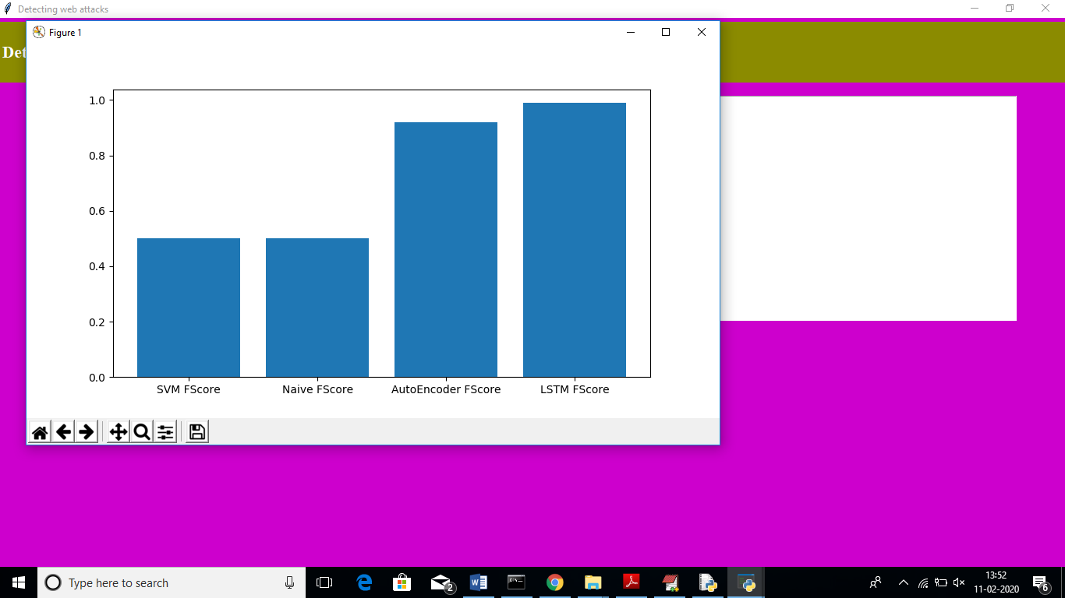

Slide 35
CONCLUSION
To validate our intrusion detection system, we created several test applications and synthetic trace datasets and then evaluated the performance of unsupervised learning against these datasets. While cross validation is widely used in traditional machine learning, it is often not used for evaluating deep learning models because of the great computational cost.

Slide 36
FUTURE SCOPE
In future work, we plan to investigate more complex network structures such as LSTM autoencoders or autoencoders with CNNs. We would like to see whether these structures can provide better accuracy for web attack detection tasks. Although the results show that the autoencoder outperforms other approaches, there is still significant research needed to be done to show performance on zero-day attacks. The results show promise that autoencoders will be able to potentially detect zero-day attacks, but more research in this area is still needed. A fundamental challenge of this work will be assessing efficacy of autoencoders against attacks that are unknown.

Slide 37
REFERENCES
1. Halfond WG, Viegas J, Orso A. A classification of sql-injection attacks and countermeasures. In: Proceedings of the IEEE International Symposium on Secure Software Engineering. IEEE; 2006. p. 13–5.
2. Wassermann G, Su Z. Static detection of cross-site scripting vulnerabilities. In: Proceedings of the 30th International Conference on Software Engineering. ACM; 2008. p. 171–80.
3. Di Pietro R, Mancini LV. Intrusion Detection Systems vol. 38: Springer; 2008.

